Slide 1

Bus Ticket System
Trainee Project
Binit Bhattarai

Slide 2
Objective
Develop a Full-Stack Web Application – Implement a comprehensive bus ticket booking system using Spring Boot for the backend and Angular for the frontend learned during traineeship.
User Authentication & Role Management – Implement secure login and user roles (passengers, admins, and bus operators) to manage access levels.
Bus Scheduling & Ticket Booking – Design features for bus management, seat selection, real-time availability updates, and ticket reservations.
Admin Dashboard & Reporting – Provide administrators and operators with a dashboard for managing bus, users, and system analytics.

Slide 3
Tech Stack
Java
Spring Boot
Angular
HTML/CSS

Slide 4
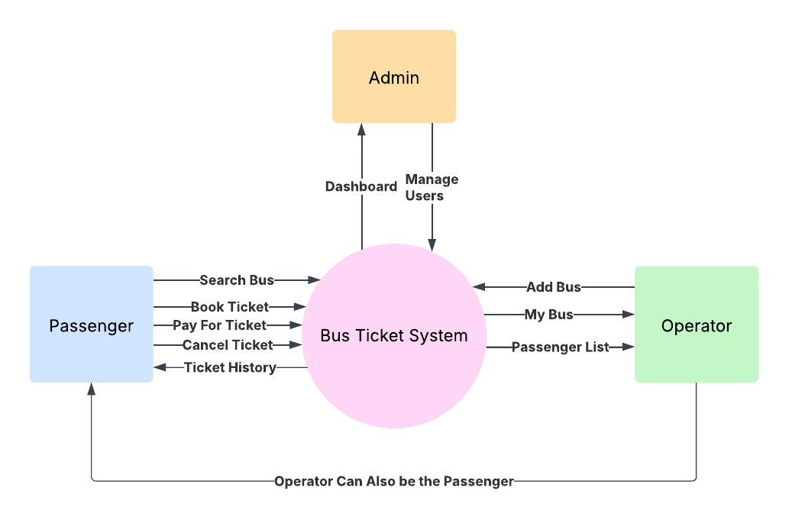
System Design

Slide 5
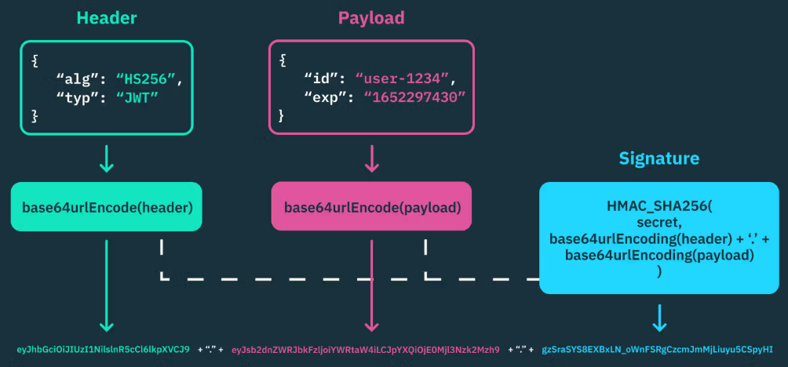
Security
Used JWT (JSON Web Token) for authentication.
Created using HMAC-SHA256 key.
JWT has three parts: Headers, Payload, Signature
Each request from the frontend is intercepted and an Authorization Header is added with `Bearer {token}`

Slide 6
Roles & Functionality
Admin
Has access to make changes to all passengers and operators.
Has a dashboard showing the information about all user activity.
Operator
Has a dashboard showing the information about all their buses.
Can add and delete a bus.
Passenger
Can book a ticket in the bus and cancel it.
Can book a ticket in the bus.
Can delete passenger tickets in their bus.

Slide 7
API Endpoints
API | Authorization
GET/DELETE(All Users, All Bus, All Tickets) | Admin
POST/GET/DELETE(Bus/:userid) | Operator
POST/GET/DELETE(Tickets/:userid) | Passenger and Operator
GET(Dashboard) | Operator and Admin
POST(Register, Login)/PUT(Users/:userid) | All

Slide 8
Angular & Frontend
Angular is used to consume the API Endpoints from the Spring Boot backend.
Interfaces are defined for DTO coming from the backend for consistency and to maintain strict type rules.
ChartJS is used to create the graphs for the dashboard.
ReactiveFormModules is used for all the forms created.

Slide 9
Dashboard
The dashboard is available for the admin and the bus operators.
The dashboard shows the following:
Total Stats
Includes Total Bus, Total Tickets, Total Passengers, Total Amount, Total Vendors and averages along with a bar graph.
Daily Ticket Stats
Includes Total Ticket, Booked Tickets, Paid Tickets, Total Amount and averages for tickets made that day along with a pie graph.
Daily Bus Stats
Includes Total Bus, Total Vendor, Total Amount, Total Passenger and averages for buses with journey on that day with a bar graph

Slide 10
Conclusion
In conclusion, the Bus Ticket System project provided hands-on experience with both backend (Spring Boot) and frontend (Angular) development.
The project helped in applying theoretical knowledge to a real-world web application, covering authentication, database management, and UI design.
Helped gain practical expertise in building a scalable, secure, and user-friendly full-stack application.
The experience laid a strong foundation for building more complex enterprise-level applications in the future.

Slide 11

Thank you

